Slide 1
EMPLOYEE DATA ANALYSIS USING EXCEL
STUDENT NAME: Shanmugapriya.V
REGISTER NO: 312200201
NM ID (A3A2AB54EFAD14FA0504268D0B66C80C)
DEPARTMENT: Commerce

Slide 2
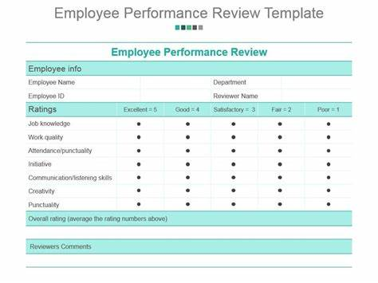
PROJECT TITLE
Employee performance analysis using Excel

Slide 3


AGENDA
Problem Statement
Project Overview
End Users
Our Solution and Proposition
Dataset Description
Modelling Approach
Results and Discussion
Conclusion
3/21/2024 Annual Review

Slide 4

PROBLEM STATEMENT
Difficulty evaluating performace:
This can lead to a high turnover, more turnover, more errors, and a reduced ability to manage improvements.
Skills gaps:
Organizations may not be aware of skill gaps in their employees, positions or groups.
Irregular performance activities:
There may be lack of regular performance reviews and management activities.

Slide 5

PROJECT OVERVIEW
A performance review, also known as employee evaluation or performance appraisal, is a formal assessment that helps identify an employee’s strengths and weaknesses, and set goals for their feature.

Slide 6


WHO ARE THE END USERS?

Slide 7

OUR SOLUTION AND ITS VALUE PROPOSITION
Conditional formatting in Excel lets you highlight information or make data stand out by aplying custom rules to cells.
The formula is often = FILTER(array, filter criteria, optional value )
Pivot table in Excel is afeature that helps you organize and summarize data in a spreadsheet.

Slide 8
DATASET DESCRIPTION
Employee – kaggle
Features – 26
Employee ID – Number
Name - Text
Employee Type
Performance level
Gender – Male and Female
Employee rating - Number

Slide 9

THE "WOW"IN OUR SOLUTION
Performance level=IFS (Z8>5,” VERY
HIGH”,Z8>=4,”HIGH”,Z8.=3,“MED”,TRUE,“LOW”
3/21/2024 Annual Review
9

Slide 10
MODELLING
1. Data collection
(1) Columns
(2) Name
(3) Role
2. Feature collection
(1) Sort
(2) Pivot table
(3) Format
3. Data cleaning
(1) Remove extra spaces
(2) Fill missing values
4. Summary
(1) Receipts
(2) Auto sum button
10

Slide 11
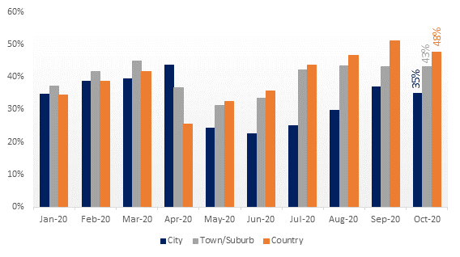
RESULTS
11

Slide 12
CONCLUSION
A conclusion of an employee performance analysis can include a summary of the employee’s performance, their strenghths, and areas for improvement.

